Slide 1


UPDATING DATA IN TABLES (UPDATE STATEMENT): MODIFYING EXISTING DATA WITHIN TABLES USING THE UPDATE STATEMENT
Oluwatosin Joshua Adebayo

Slide 2

UPDATE
It is a Data Manipulation Language (DML) used in Structured Query Language (SQL) to modify data that is already present in a database.

Slide 3

UPDATE statement works with SET when being used.
UPDATE
SET clause specifies a new value for each column that you want to update and provides the value to it.

Slide 4
Update can be used on single columns as well as multiple columns using the UPDATE statement as required.
UPDATE
While WHERE clause is used to select the rows for which the columns are needed to be updated.

Slide 5

How it Works
To update existing rows, use the UPDATE command.
This requires this pieces of information:
Table and column to update
The new value of the column
Which row(s) to update (Where)

Slide 6
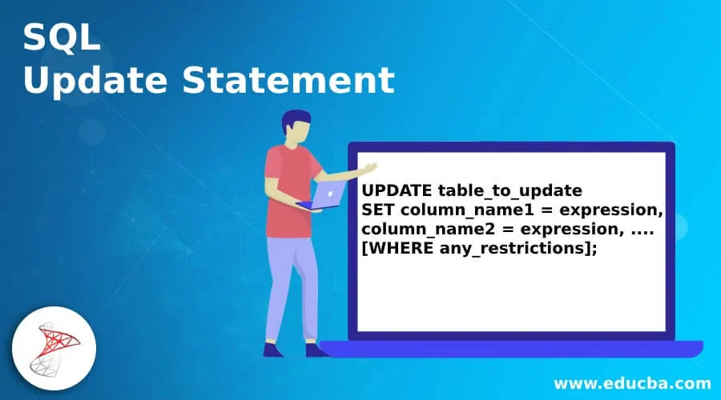
How it Works

Slide 7
QUERY EXPLANATION
UPDATE table_to_update: Name of the table
SET column_name1: Name of first column
column_name2: Name of second column
= expression: New value for first column etc.
WHERE: Condition to be used

Slide 8

What if you
forget the
WHERE
condition??????
WHERE???
Or, it is a case where the condition is not used?

Slide 9

If you have not used the WHERE clause or you omit it, SQL will update each columns in all the rows in the table with the values supplied.
So the WHERE clause is used to choose the particular rows.
REALLY???

Slide 10

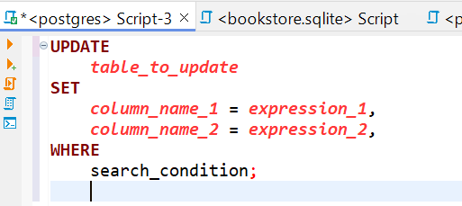
SUMMARY
With the UPDATE statement, you can change (SET) the value of one or more columns in each row that meets the search condition of the WHERE clause.
The result of the UPDATE statement is one or more changed column values in zero or more rows of a table depending on how many rows meets the search condition specified in the WHERE clause.

Slide 11



Thank you For Listening
ayojoshua01@gmail.com

